Slide 1
Home Control Systems from Duplantis
SUSHIL AHUJA

Slide 2
Duplantis Smart Home Features
Control electronic devices remotely
Turn lights on or off throughout the house
Check for open doors and windows
Arm or disarm security system
Adjust thermostat settings
Click to see a typical setup
Notes:
Link the first bullet to Slide 4.

Slide 3
What Do I Need?
Wireless switches and outlets
Open/Close detectors
Wireless router
Wireless device
Computer
Smart phone
Tablet
Duplantis remote
Get a quote

Slide 4
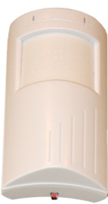


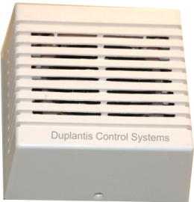

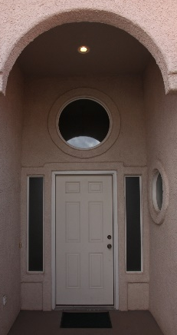
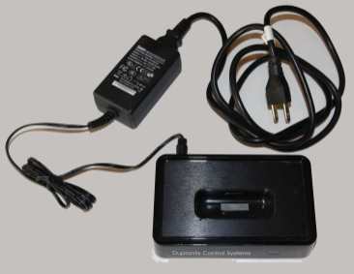

How Does It Work?
Motion Sensors
Start the app on smart phone or tablet
Control any device with a sensor or plugged into wireless outlet
Wall Speakers
Security Alarms
MP3 Player Docking Station
Porch Light

Slide 5
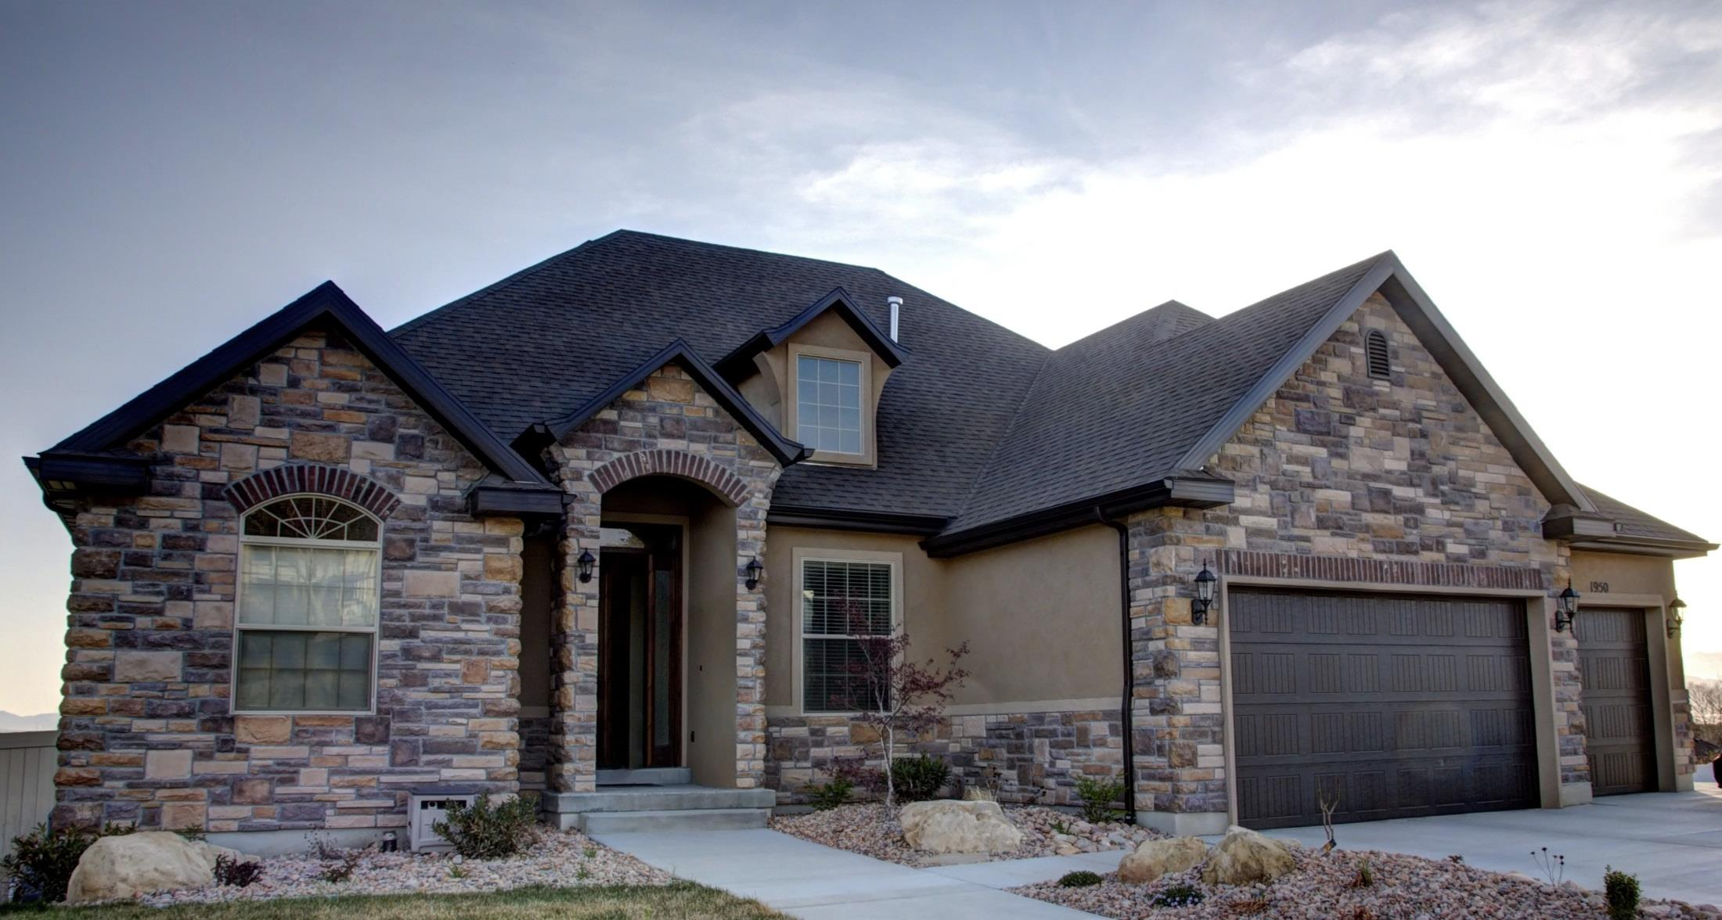
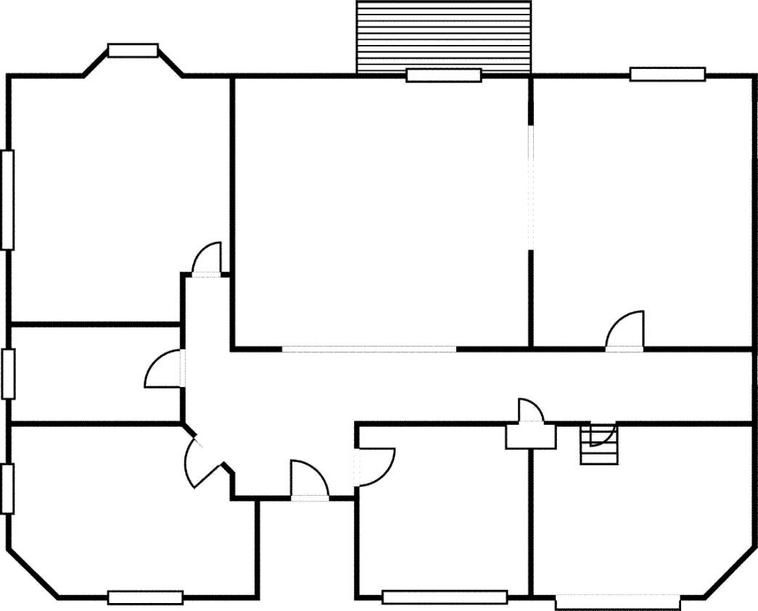




Typical Device Plan

Slide 6
Get a Free Quote Today!
www.duplantissystems.example.com
1471 Main Street Cary, NC 27511
(919) 555-4900

